Slide 1

Major Project Presentation on
ELECTRONIC GADGET ADDICTION PREDICTION USING MACHINE LEARNING
By
M. Rupika (22C91A05A8)
M. Mythri (22C91A05B4)
G. Nandhini (22C91A0568)
K. Vasu (22C91A0593)
M. Abhiram (2291A05B8)
Under the Guidance of Project Coordinator Head of the Department
MR. N. SHIVALINGAM R. D. PRASAD MR .A. JITENDRA M.Tech (Ph.D.)
Assistant Professor Professor Associate Professor
HOLY MARY INSTITUTE OF TECHNOLOGY AND SCIENCE
DEPARTMENT OF COMPUTER SCIENCE & ENGINEERING
(UGC AUTONOMOUS)
( Approved by AICTE , New Delhi, Affiliated to JNTUH,, Accredited by NAAC ‘A’ grade )

Slide 2
CONTENTS
Abstract
Introduction
Literature Survey
Existing System
Block Diagram
Proposed System
Block Diagram
Advantages
Disadvantages
Applications
Conclusion

Slide 3
ABSTRACT
Electronic gadgets such as smartphones, tablets, and laptops are widely used in today’s technology-driven world.
These devices improve productivity and connectivity but excessive use has created a growing problem of gadget addiction.
Gadget addiction is increasing especially among students and young professionals. The project aims to build an intelligent system that predicts the likelihood of electronic-gadget addiction.
Machine learning techniques are used to analyze user behavior and usage patterns.
Key factors considered include:
  Screen time
  Social media activity
  Sleep disturbances
The system uses several machine learning algorithms such as:
  Logistic Regression
  Random Forest
  Support Vector Machine (SVM)
The model classifies users into low, moderate, or high-risk categories based on their behavior.
The research contributes to building advanced digital-health tools and spreading awareness about responsible gadget usage.

Slide 4
INTRODUCTION
Technological Growth: In the 21st century, rapid technological innovation has significantly changed how people live, work, and communicate.
Increased Gadget Dependency: The rise of digital devices has led to increased dependency on electronic gadgets, especially among teenagers and young adults.
Negative Effects of Excessive Usage: Overuse of gadgets has caused problems like reduced academic performance, sleep disturbances, anxiety, and weakened social interactions.
Impact on Mental Health & Lifestyle: Continuous screen exposure and excessive engagement in social media, gaming, and digital entertainment negatively affect mental health, productivity, and relationships.
Machine Learning for Prediction: ML techniques can analyze user behavior data such as screen time, app usage patterns, and online activity frequency to predict levels of addiction.
Use of Predictive Modeling: Classification algorithms and predictive models help identify users at risk and provide early warnings or personalized recommendations.
Goal of the Project: The system aims to promote digital wellness by helping individuals understand their digital habits and maintain a healthy balance between virtual and real worlds.

Slide 5
LITERATURE SURVEY
Paper Title | Published Year | Technique | Methodology Result
Explainable prediction of problematic smartphone use — K. Kim et al. | 2004 | LR, RF, XG Boost, SHAP | Used survey + usage data. Identified key predictors like screen time and personality. RF/XG Boost showed best performance.
ML prediction of adolescent Internet addiction — Y. Gan et al. | 2025 | XG Boost, RF, LR | Adolescent survey dataset. Psychological + demographic features. XG Boost achieved highest accuracy and identified risk factors.
Explainable ML for Internet addiction — J. Liu | 2025 | Gradient Boosting, SHAP | Large behavioral dataset. Feature engineering + imbalance handling. Strong AUC; cognitive/emotional features most predictive.
Predicting Smartphone Addiction in Teenagers | 2023 | SVM, RF, LR | Teen survey + personality traits. Cross-validation. Moderate accuracy; neuroticism strongly associated with addiction
ML Model for Smartphone Addiction — Indianapublications | 2024 | Decision Tree, RF, LR | Undergraduate survey dataset. Screen habits analyzed. RF achieved ~0.74 accuracy.
Predictive Modeling of Gadget Addiction — IJCRT | 2025 | Decision Tree, RF | Students (18–25) dataset. Behavioural + psychological features. RF performed best; screen-time & anxiety strongest predictors

Slide 6
EXISTING SYSTEM
1. Smartphone Usage Monitoring
Tracks screen time, app usage, number of unlocks.
ML models analyze patterns to detect excessive usage.
2. Survey-Based Psychological Assessment
Uses questionnaires like Smartphone Addiction Scale.
ML classifiers predict risk levels: low, medium, or high addiction.
3. Social Media & Online Activity Analysis
Monitors time spent on social media, gaming, browsing.
ML identifies addictive behaviour from abnormal engagement patterns.
4. Wearable-based Monitoring Systems
Track sleep patterns, physical activity, heart rate.
ML models identify correlations between reduced sleep/physical activity and high gadget usage.
Useful for adolescents and adults.

Slide 7
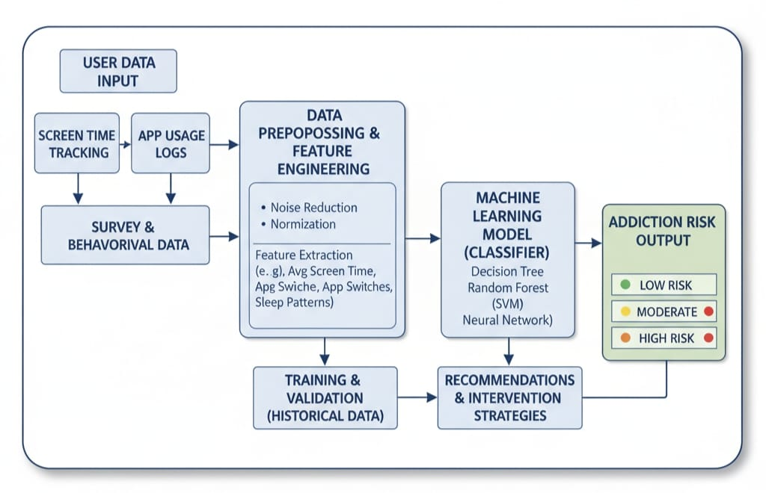
BLOCK DIAGRAM

Slide 8
EXPLANATION
1.User Data is Collected
The system collects screen time, app usage logs, and survey/behavior data from the user.
2. Data is Cleaned and Processed
The collected data is corrected, filtered, and normalized.
Important features like average screen time, most used apps, sleep patterns, etc., are extracted.
3. Machine Learning Model is Trained
Historical data is used to train the model. Algorithms like Decision Tree, Random Forest, SVM, or Neural Networks learn patterns of addiction.
4. Model Predicts Addiction Risk
The trained model analyzes the user’s data and predicts whether the user is at low, moderate, or high risk of gadget addiction.
5. System Gives Recommendations
Based on the addiction level, the system provides tips or strategies to reduce overuse and maintain healthy digital habits.

Slide 9
PROPOSED SYSTEM
Advanced Data Collection
The proposed system collects detailed app usage, screen time, sleep patterns, emotional state, and notification behavior. This gives a richer dataset than existing systems for more accurate prediction.
2. Intelligent Data Preprocessing
Data is cleaned, normalized, and converted into meaningful formats for machine learning. Irrelevant or noisy data is removed to improve model accuracy.
3. Feature Engineering with Behavioral Indicators
Features like late-night usage, unlock frequency, rapid app switching, and mood changes are extracted. These behavioral indicators help detect early signs of digital addiction.
4. Use of Hybrid Machine Learning Models
The system combines algorithms like Random Forest, SVM, and LSTM to analyze both static and time-based data. Hybrid models provide higher accuracy and better learning of user behavior patterns.
5. Personalized Addiction Prediction
The model predicts the user's addiction level (Low, Medium, High) based on learned patterns. Personalization ensures predictions match individual habits rather than general trends.

Slide 10
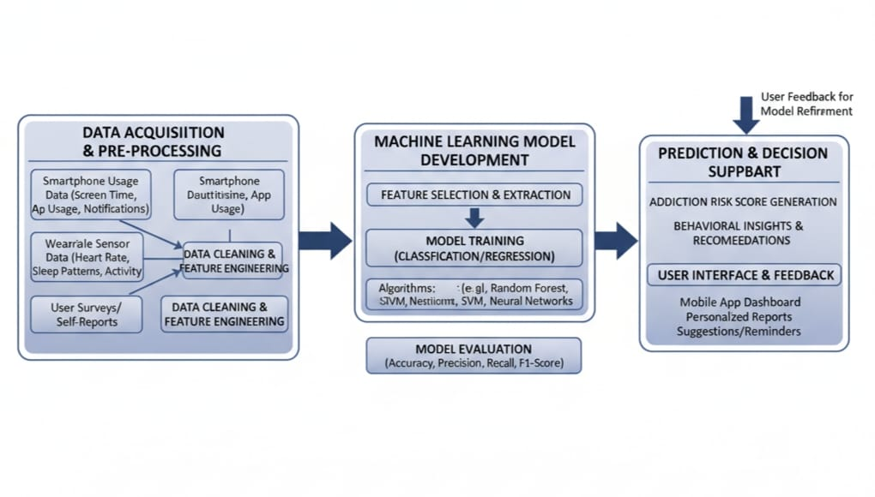
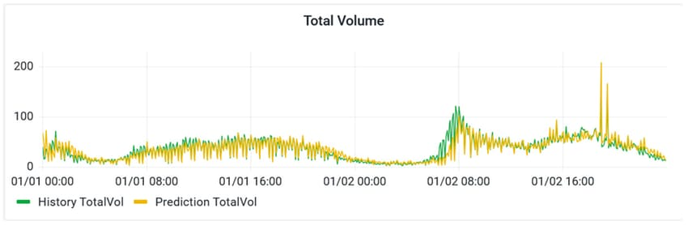
BLOCK DIAGRAM

Slide 11
EXPLANATION
1. Data Acquisition & Pre-Processing
Collects data from:
Smartphone usage (screen time, app usage, notifications)
Wearable sensors (heart rate, sleep, physical activity)
User surveys/self-reports
Performs: Data cleaning (removing errors, duplicates)
Feature engineering (creating useful variables from raw data)
2. Machine Learning Model Development
Feature selection: choose the most important data features.
Model training using ML algorithms: Random Forest, SVM, Neural Networks, Others (classification or regression)
Model evaluation using metrics:Accuracy,Precision,Recall,F1-Score.
3. Prediction & Decision Support
Generates addiction risk score for users.
User interface shows: Dashboard, Personalized reports, Suggestions & reminders.
User feedback is used to improve the model further.

Slide 12
ADVANTAGES
        Personalized Insights: Provides feedback based on the user’s real usage patterns.
        Automated Analysis: Works continuously without manual checking.
        Higher Accuracy: ML models reduce human error in identifying addiction.
        Behavior Improvement: Helps users control screen time with meaningful suggestions.
        Real-Time Monitoring: Tracks usage instantly for timely alerts.
        Data-Driven Decisions: Encourages healthy digital habits based on evidence.
        Scalable System: Can easily support many users with the same model.

Slide 13
DISADVANTAGES
Data Privacy Concerns: Users may worry about their usage data being collected.
Model Inaccuracy: Wrong predictions may occur with poor or incomplete data.
Battery Drain: Continuous monitoring can reduce battery life.
Over-Monitoring Feeling: Users may feel uncomfortable being tracked.
Sensor Dependency: Accuracy decreases if device sensors or permissions fail.
Limited Generalization: Model may not work equally well for all age groups or lifestyles.
Requires Regular Updates: ML models need frequent retraining to stay accurate.
Potential Misinterpretation: Users might misunderstand the risk level shown by the system

Slide 14
APPLICATIONS
Health & Wellness Apps: Helps users monitor and control excessive screen time.
Educational Institutions: Identifies students with high gadget dependency for timely guidance.
Parental Control Systems: Assists parents in tracking and managing children’s device usage.
Workplace Productivity Tools: Detects overuse that affects employee focus and efficiency.
Digital Detox Programs: Supports therapy or counseling by providing behavior data.
Research & Studies: Helps psychologists and researchers analyze digital addiction patterns.

Slide 15
CONCLUSION
The project proved that machine learning can accurately predict electronic gadget addiction.
It collected key behavioral data and converted it into meaningful features.
The system successfully classified users’ addiction risk with good accuracy.
It provided helpful insights for understanding digital usage patterns.
ML prediction showed practical value for early detection of unhealthy gadget habits.
The project achieved all its objectives with a functional prediction model.
The results showed that technology can help promote healthier and balanced gadget use.

Slide 16
THANK YOU…

